Slide 1
RN & Navigator (tab-bar)

Slide 2
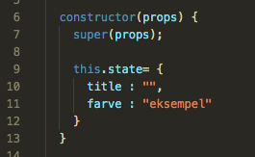
Remarks fra sidst
Watchman problemer
Guide til installation
Mac skal bruge Homebrew
”initial state”
GitHub link
” git clone ”
” npm i ”

Slide 3
Agenda for i dag
Lidt om react native og dets historie
App navigation og tab bar

Slide 4
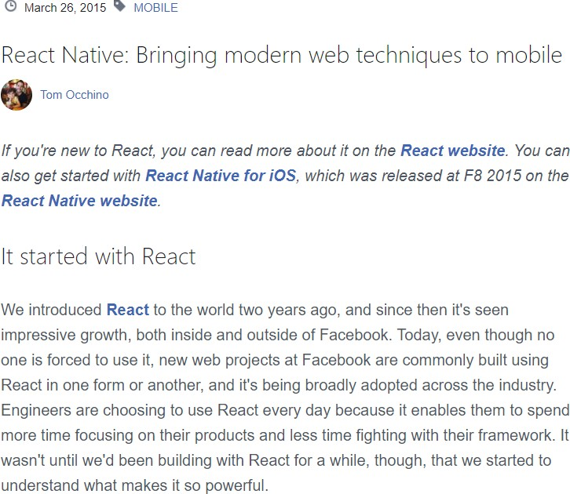
a brief history of react native
› Sommer 2013: Startede som Facebooks interne hackathon projekt
› Januar 2015: Første offentlige fremvisning til ”React.js con”
› Marts 2015: Offentliggjort på GitHub som et open source framework

Slide 5

react native community
› Er blevet et af de mest populære frameworks
› 1.713 contributors, 67.427 stars, og15.270 forks i GitHub
› Rangeret som GitHubs niende største repository

Slide 6
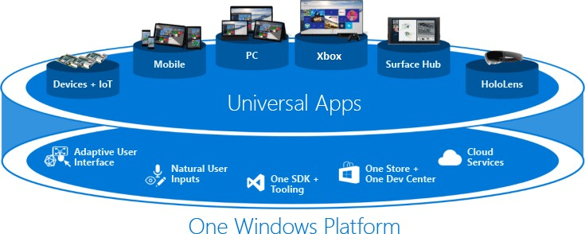
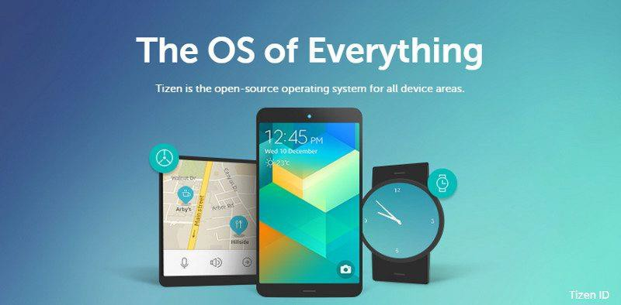
støttet af tech giants
› Microsoft bruger React Native i deres Universal Windows Platform (UWP)
› Samsung bruger React Native i Tizen, som er deres OS for IoT devices

Slide 7
fordele ved react native
Compatibility
Performance
Integratability
Community
Efficiency
Expendability
React Native supports IOS, Android, Windows, and Tizen OS
React Native is built on native components
Achieve the speed, look, and functionality of native app
Integrate with native codes with minimum modification
Backed by the largest and most active opensource community
Develop native app with the speed and agility of web app development
Focus on what matters to your business
Incorporate native third- party components

Slide 8
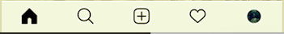
app nagivation
User Experience
Tab bar
Drawer
(Burger menu)
Tilbageknap

Slide 9
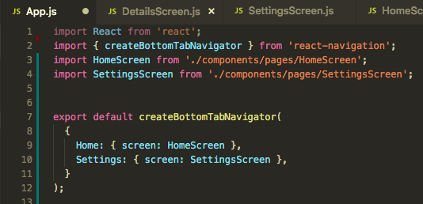
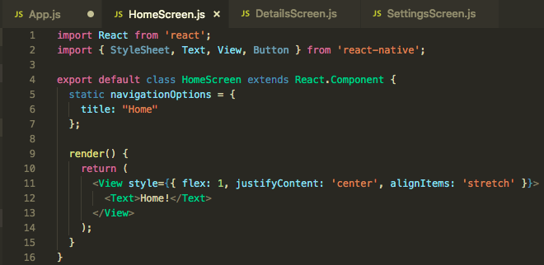
tab bar
createBottomTabNavigator()

Slide 10
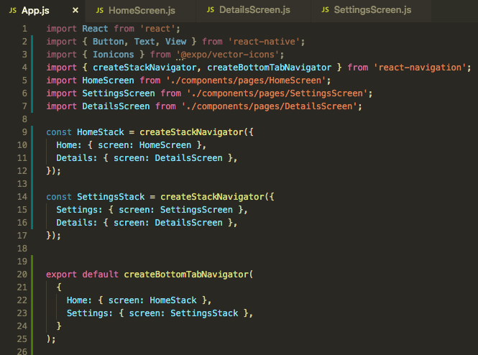
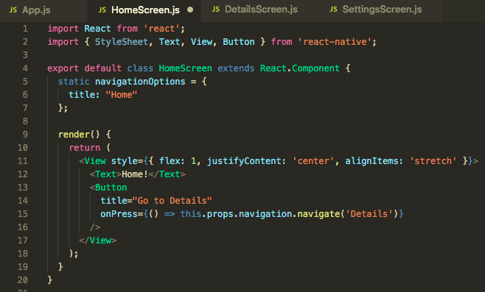
tilbageknap
createStackNavigator()

Slide 11
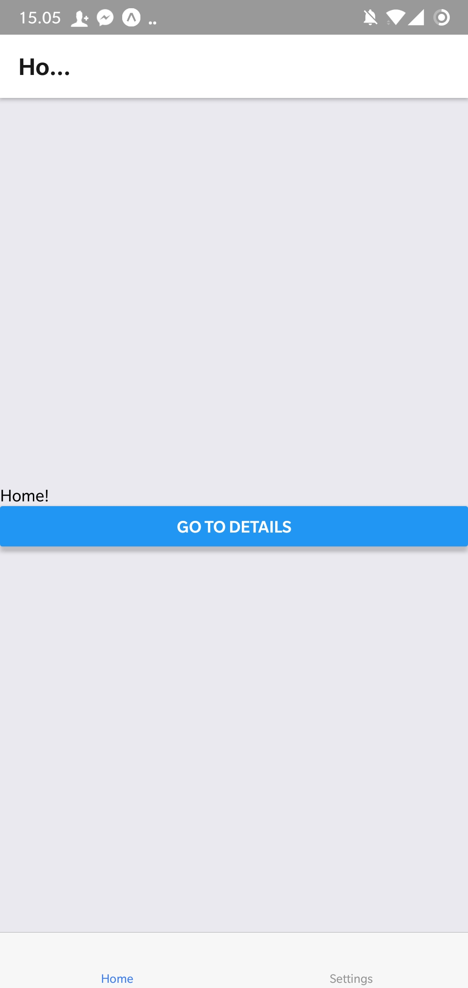
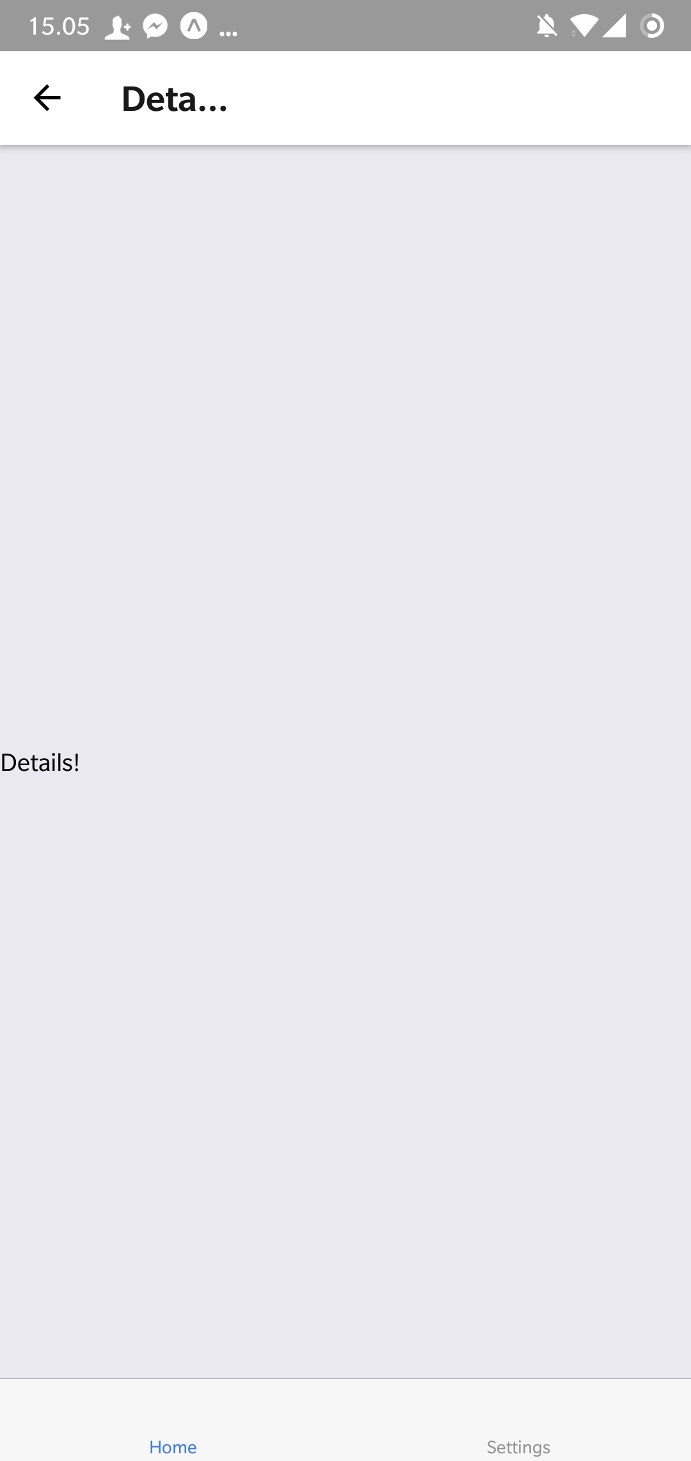
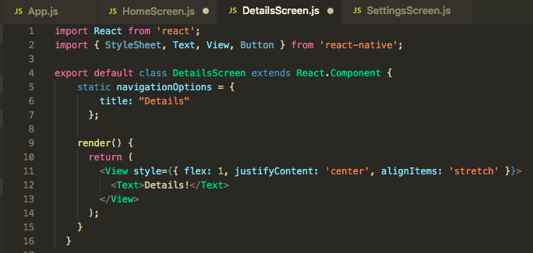
tilbageknap
createStackNavigator()

Slide 12
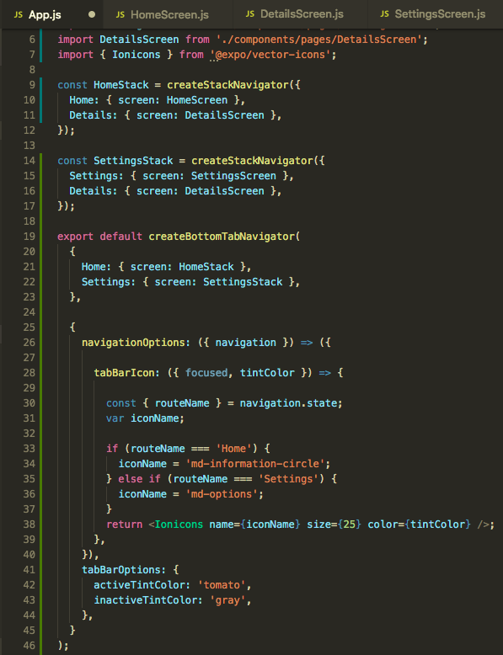
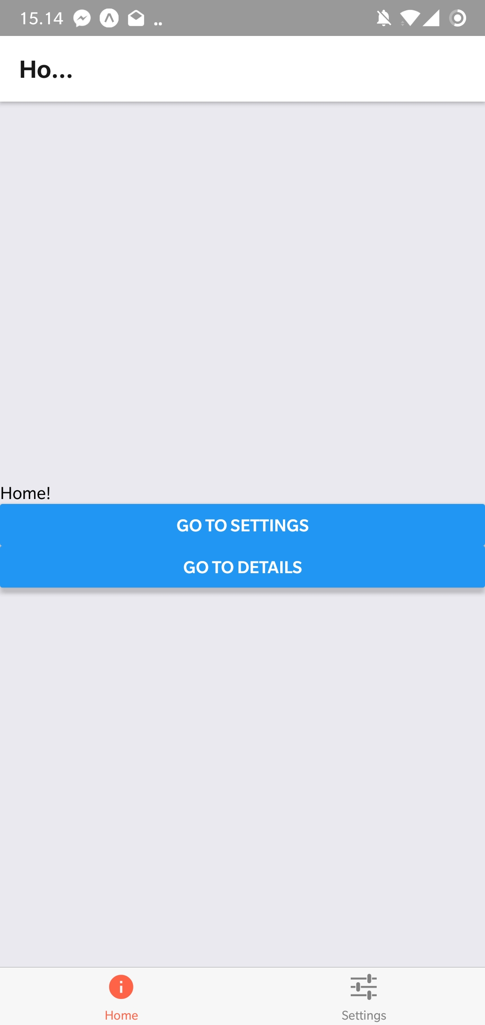
tab bar icons
createStackNavigator()
liste med icons

Slide 13
øvelser

